Slide 1
DevOps Workshop, Part I

Slide 2
Agenda
WHY do we need this?
To understand what is waiting ahead.
DAY 1
Learn about docker containers.
Get acquainted with Kubernetes basic concepts.
Try launching your minimal stateless application.
Explore Kubernetes networking.
DAY 2
Learn how to configure your app on-the-go.
Go stateful.
Learn about templating.
DAY 3
Give your knowledge a challenge in DevOps practical task.
2

Slide 3
Legend
WHY do we need this?
To understand what is waiting ahead.
Types of slides
Practice
Q&A: story
Piece of theory
3

Slide 4
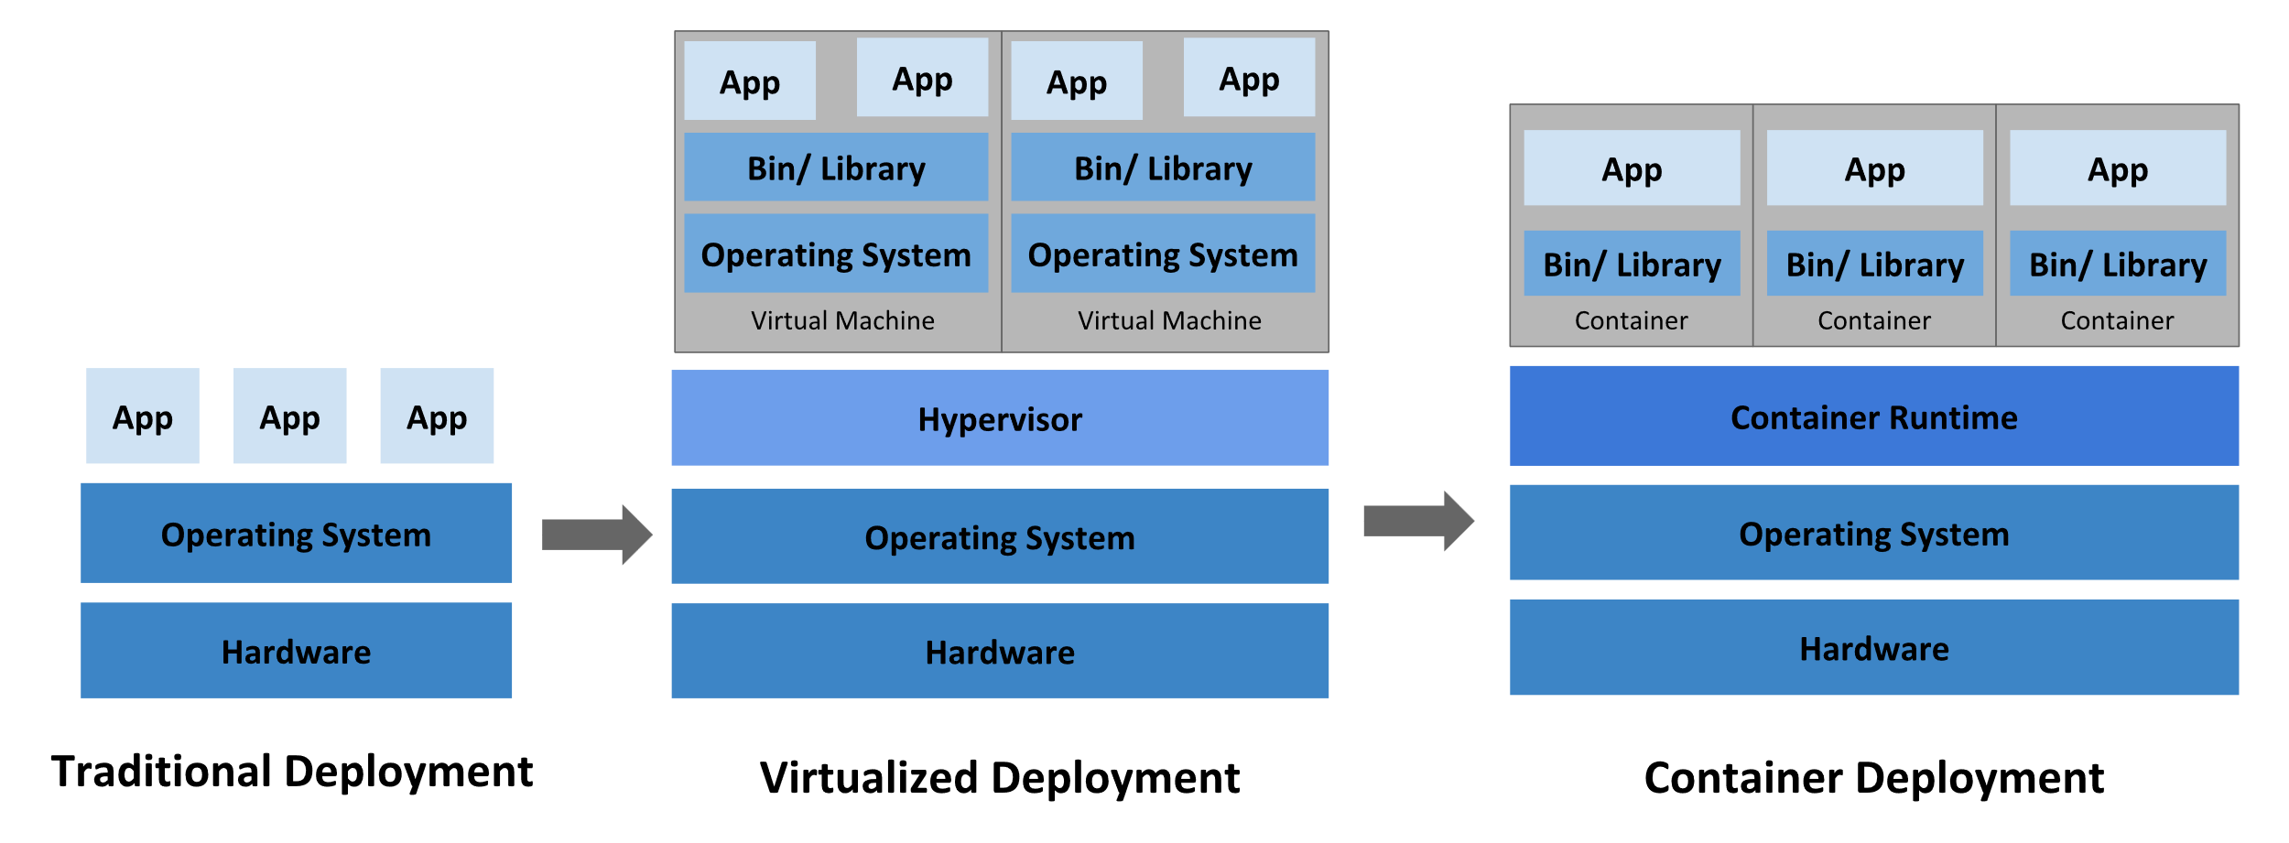
History
4

Slide 5
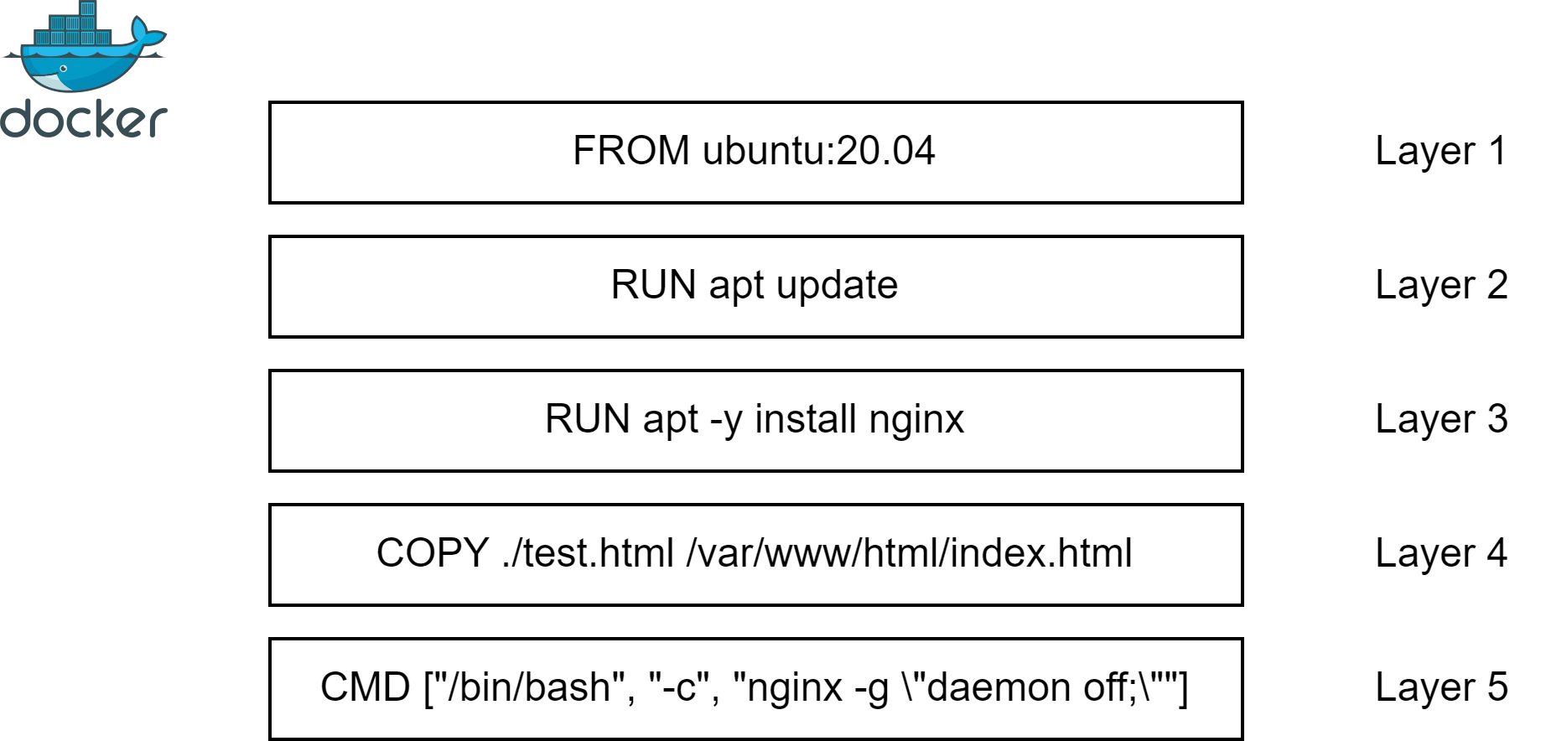
Docker Containers
WHY do we need this?
To simplify deployment process and increase resource utilization.
5

Slide 6


Q&A: story
WHY do we need this?
To see usecases.
It would be great to create world-level online tea-shop!
Well, you need scalable and configurable, platform-agnostic solution, like docker containers.
Alice
Bob
6

Slide 7
Task
WHY do we need this?
To practice (:
Create Docker image that prints
“Hello world! $date $NAME” message, where is $date is current date and $NAME is value of NAME environment variable. Use fredblgr/ubuntu-novnc:20.04 as a base image. To have script automatically executed, place it under the folder /etc/startup/. Set value of RELATIVE_URL_ROOT to yourname.
Test it and push to ECR registry with tag matching your name.
7

Slide 8
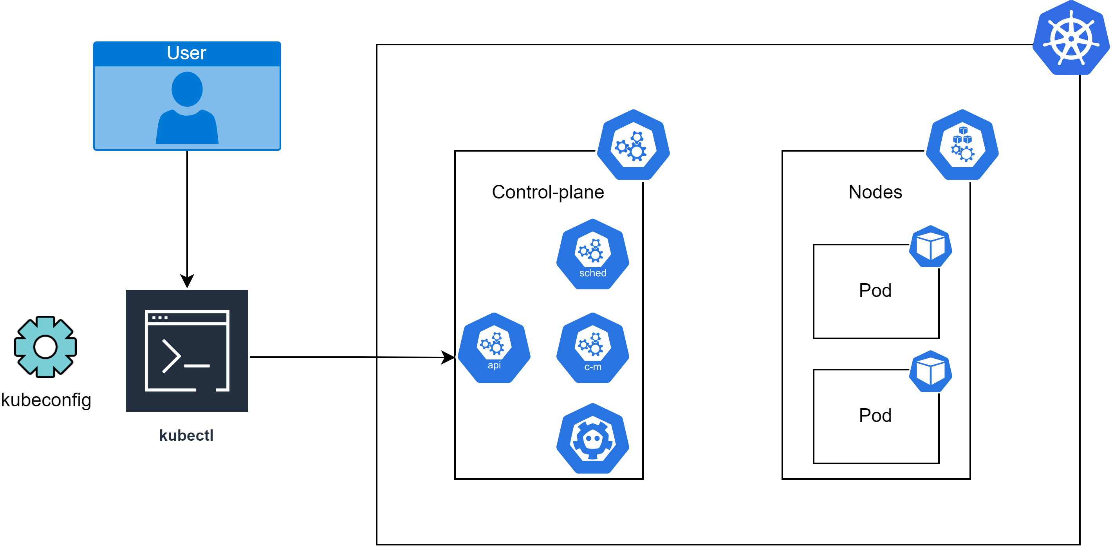
Kubectl
WHY do we need this?
To be able to deploy resources to cluster.
Scheduler - schedules pods
Controller-manager aka
“cluster internal processes manager”
API server aka
“control-plane frontend”
ETCD aka
“cluster distributed backup storage”
8

Slide 9
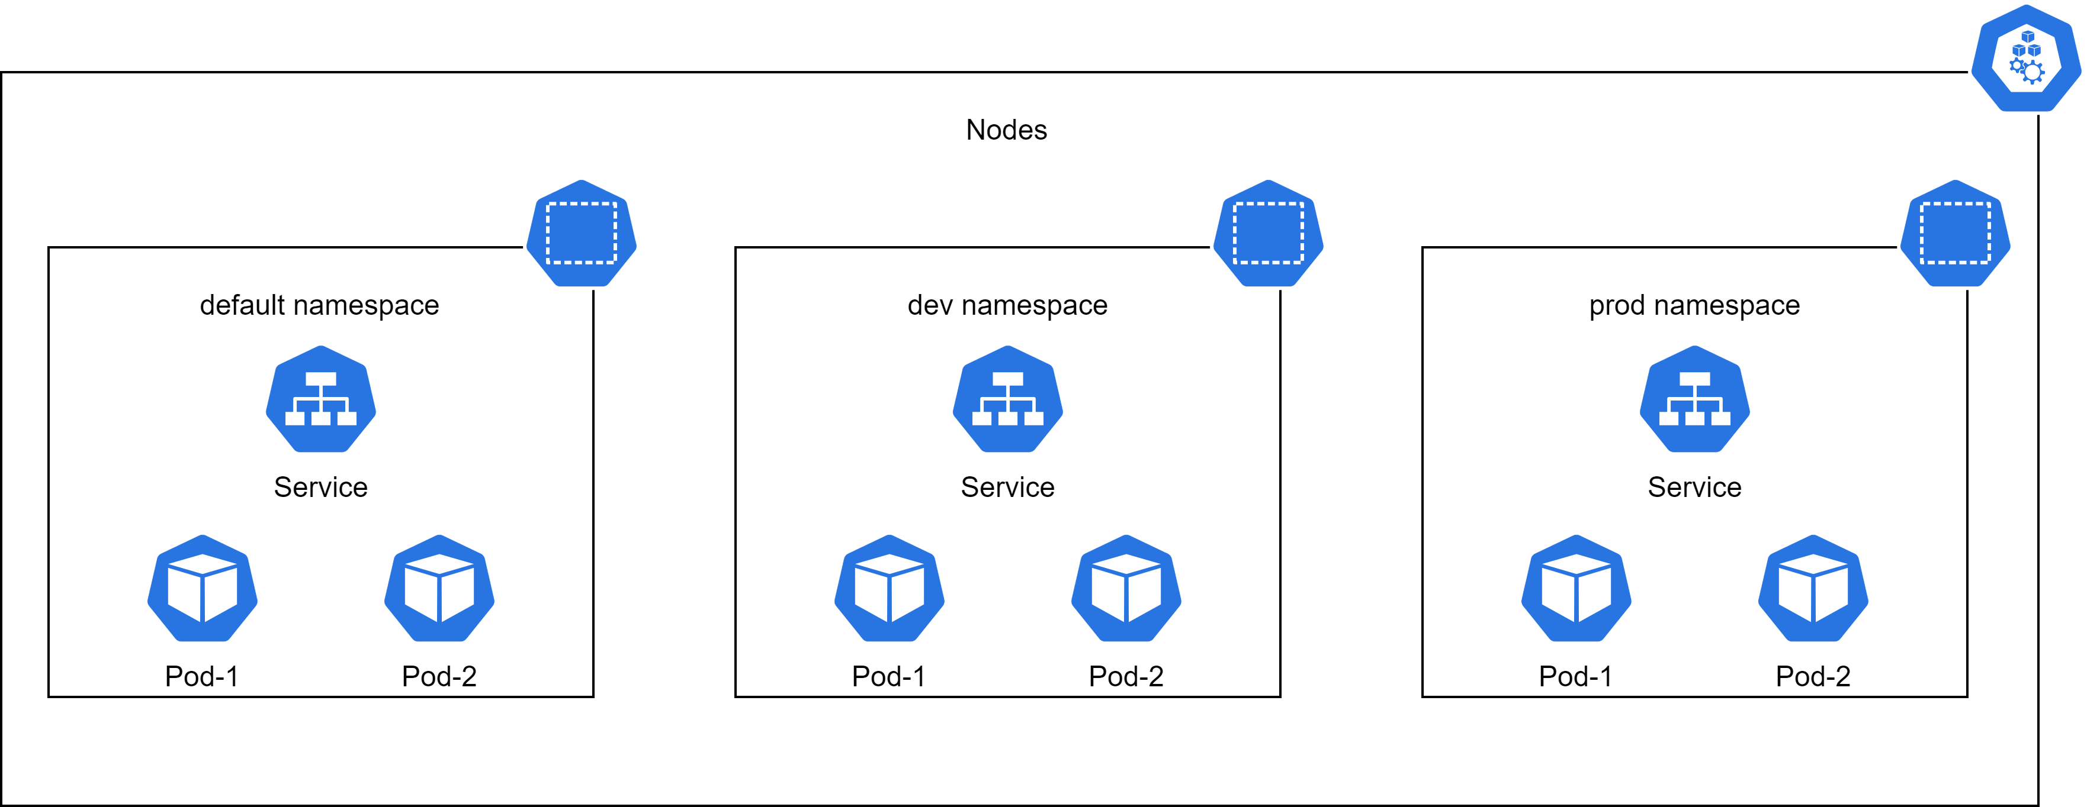
Nodes and Namespaces
WHY do we need this?
Nodes – to run docker containers, Namespaces - to simplify resource management, like folders for files.
9

Slide 10
Q&A: story
WHY do we need this?
To see usecases.
I need deployment, configuration and maintenance automatization for docker containers.
Well, you need container orchestration system like Kubernetes.
Alice
Bob
10

Slide 11
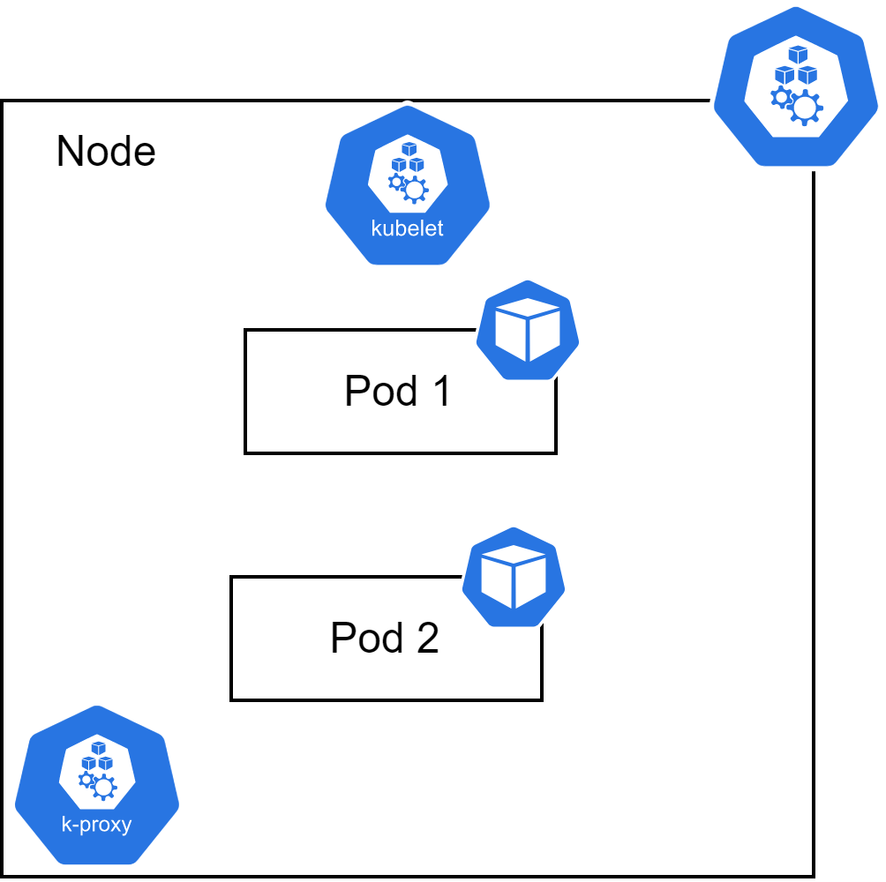
Pods
WHY do we need this?
To configure and run docker container in an efficient way.
11

Slide 12
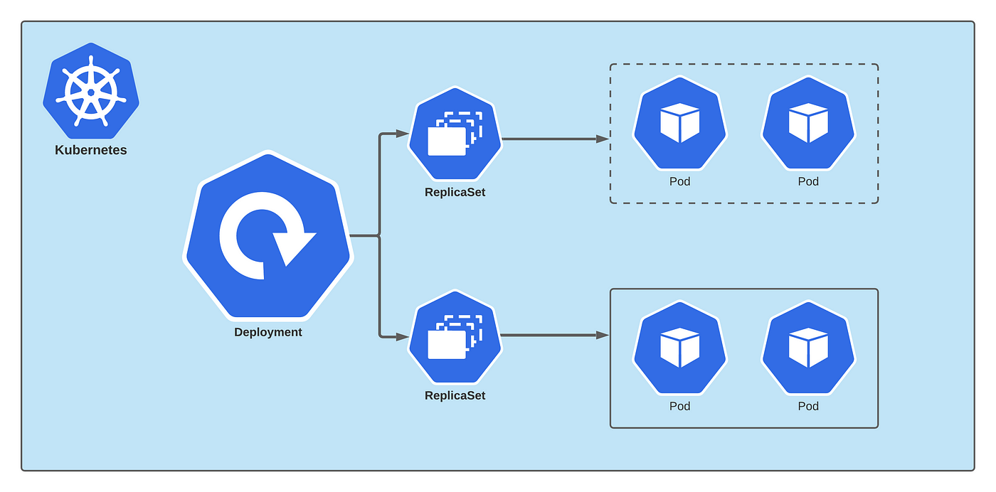
Deployment
WHY do we need this?
To make pods scalable and fault-tolerant.
12

Slide 13
Deployment Affinity
WHY do we need this?
To manage scheduling process for pods.
Affinities
Node
Pod
Affinities
Affinities
Affinity
AntiAffinity
Required
Preferred
13

Slide 14
Q&A: story
WHY do we need this?
To see usecases.
I need to make my online tea-shop frontend scalable and fault-tolerant.
Try using deployment: it is ideal for this.
Alice
Bob
14

Slide 15
Task
WHY do we need this?
To practice (:
Create deployment with 1 replica for your docker image. Expose port 80. Check logs of the pod. What do you see? ;)
15

Slide 16
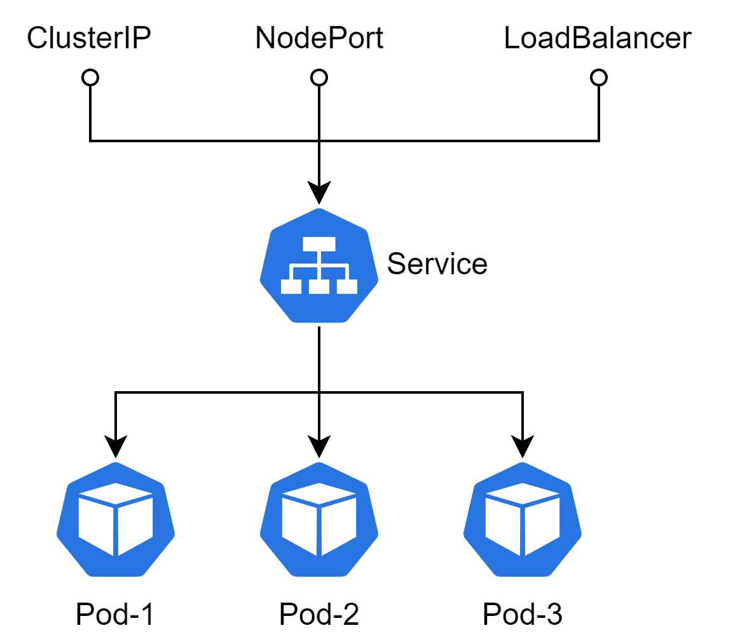
Service
WHY do we need this?
To loadbalance traffic across pods.
16

Slide 17
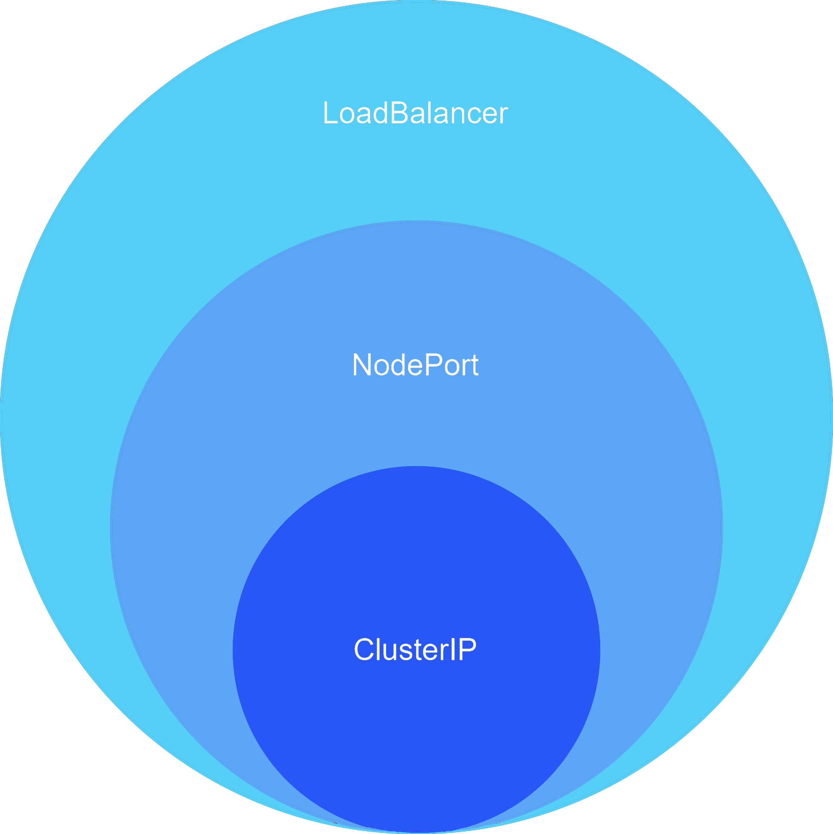
Service exposing
WHY do we need this?
To make service accessible from outside.
17

Slide 18
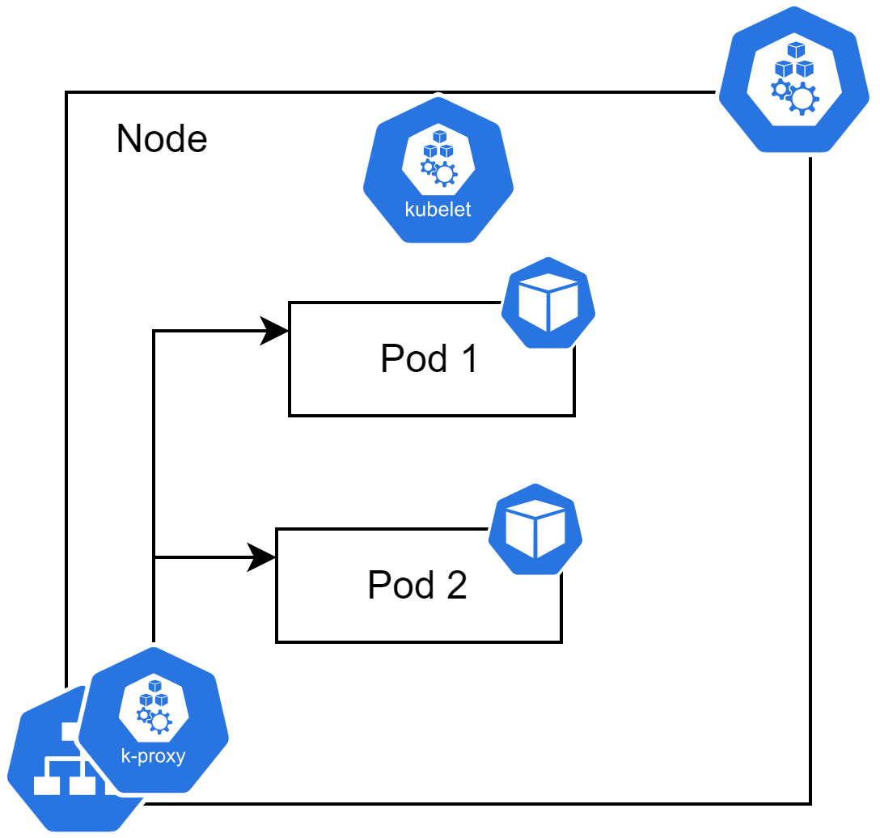
Service high level
WHY do we need this?
To understand how it works in reality.
18

Slide 19
Q&A: story
WHY do we need this?
To see usecases.
But how clients would access all those pods?
Service is the answer! It provides single endpoint for all pods and takes care of loadbalancing task.
Alice
Bob
19

Slide 20
Task
WHY do we need this?
To practice (:
Create service for your deployment of type ClusterIP. Use kubectl port-forward to get access to your app.
20

Slide 21
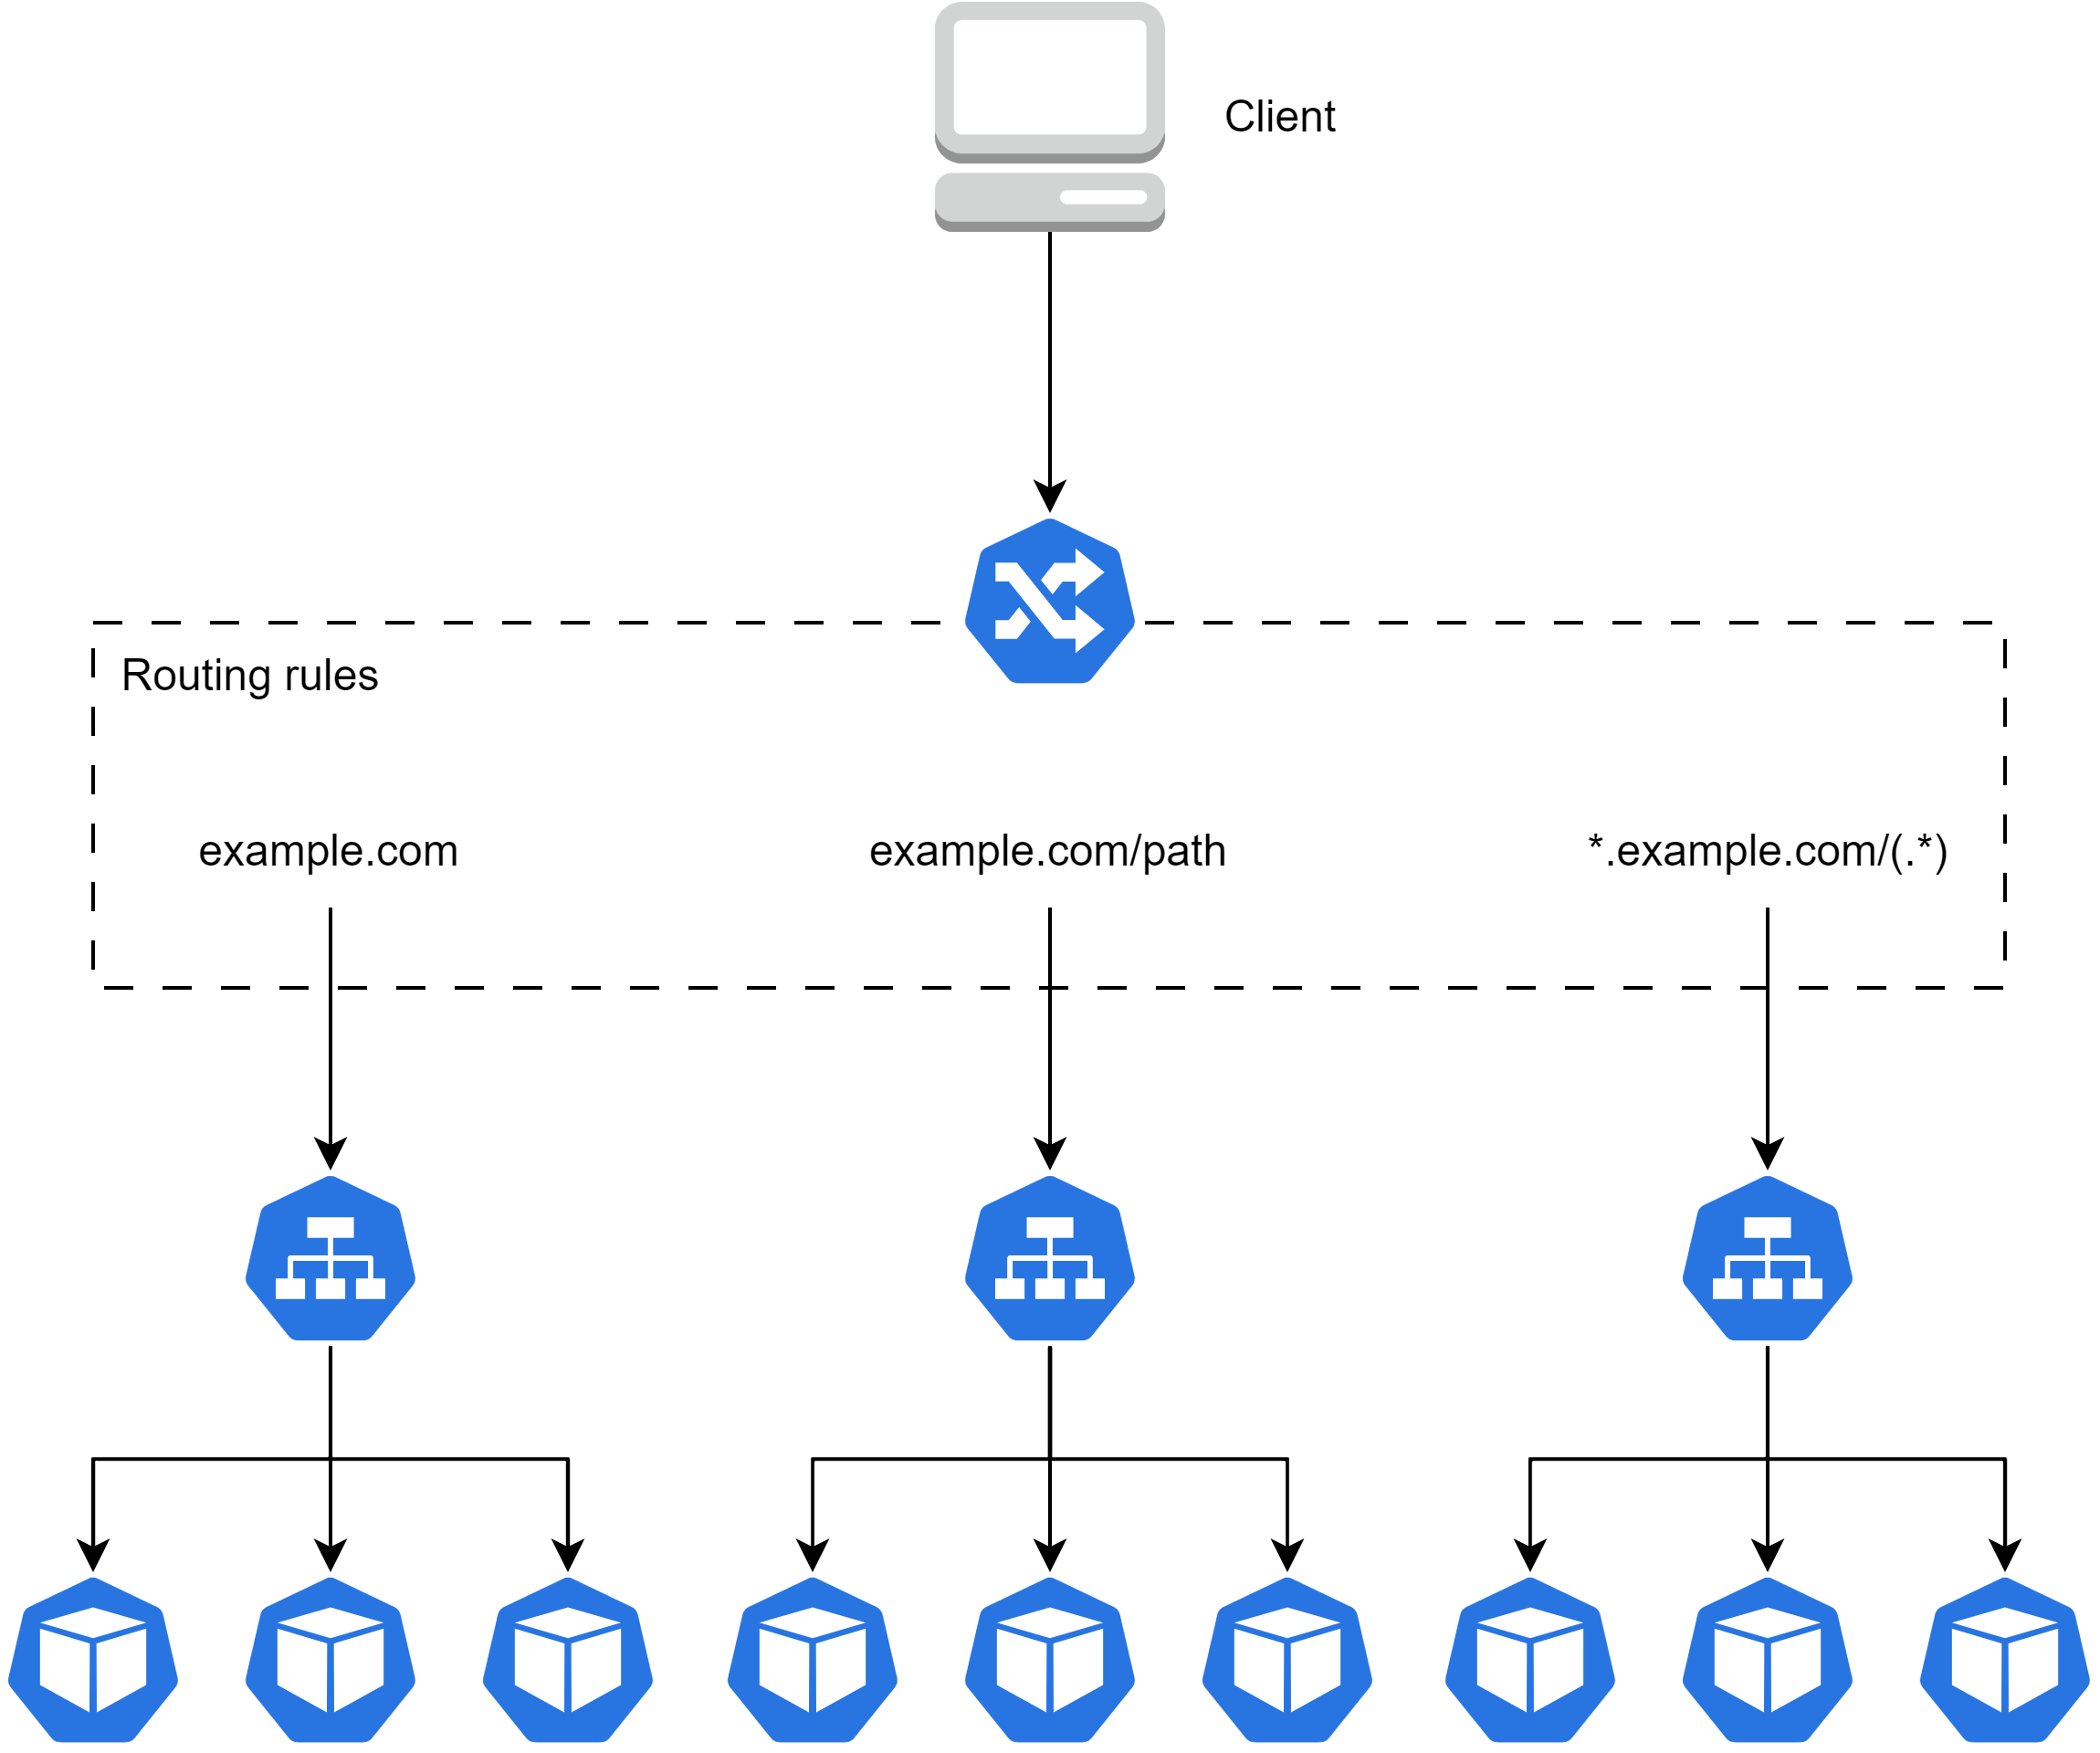
Ingress
WHY do we need this?
To expose service to otter world.
21

Slide 22
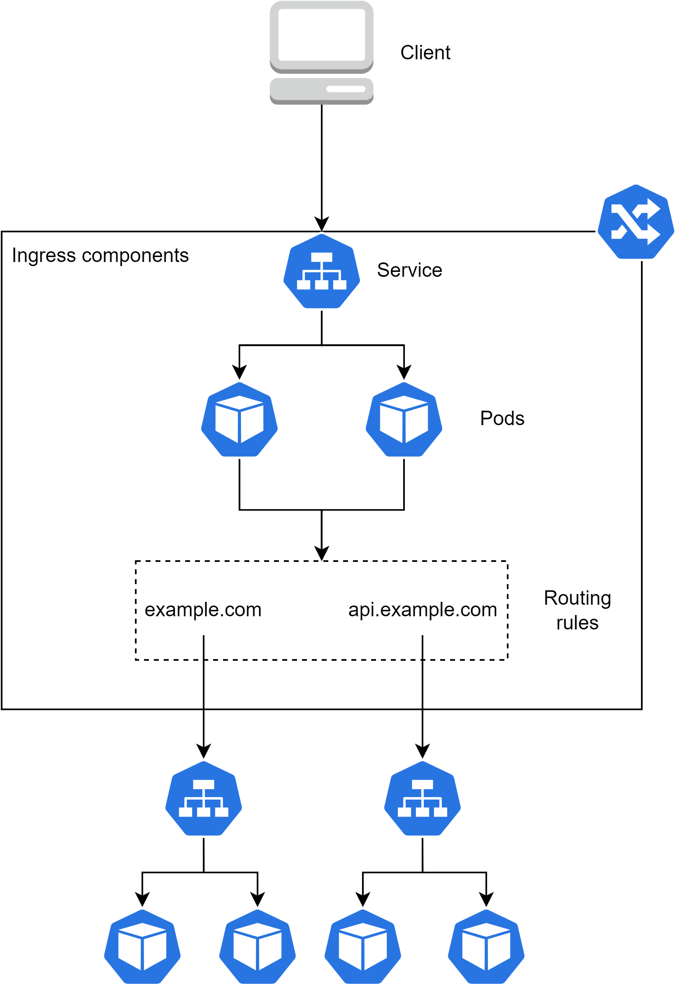
Ingress high level
WHY do we need this?
To understand how it works in reality.
22

Slide 23
Q&A: story
WHY do we need this?
To see usecases.
And what if I have multiple services? How I would make them accessible from otter world?
Ingress would do the job for you.
Alice
Bob
23

Slide 24
Task
WHY do we need this?
To practice (:
Create ingress to expose your service on path “/yourname/”. Access it via loadbalancer link.
24

Slide 25
Reference
WHY do we need this?
To broaden knowledge.
Name | Link
Dockerfile | https://docs.docker.com/engine/reference/builder/
Docker | https://docs.docker.com/engine/reference/run/
Kubernetes | https://kubernetes.io/docs/concepts/overview/
Kube-components | https://kubernetes.io/docs/concepts/overview/components/
Pods | https://kubernetes.io/docs/concepts/configuration/configmap/
Namespaces | https://kubernetes.io/docs/concepts/overview/working-with-objects/namespaces/
Deployment | https://kubernetes.io/docs/concepts/workloads/controllers/deployment/
Service | https://kubernetes.io/docs/concepts/services-networking/service/
Ingress | https://kubernetes.io/docs/concepts/services-networking/ingress/
25

